Slide 1
Operational Transformation

Slide 2
What is Operational Transformation?
is an optimistic consistency control method in collaborative editing system or groupware.
OT is able to maintain shared document consistency while allowing multi-users to generate operations freely and concurrently and the system to respond to local users quickly and execute remote operations in different orders.
Extended capabilities of Operational Transformation:
Consistency maintenance.
Concurrency Control.
Group undo.
Locking.
Conflict resolution.
Operation notification and compression, group-awareness.
HTML/XML and tree-structured document editing.

Slide 3
Consistency maintenance in OT
In a distributed system, all the shared document should be same as one another.
Consistency Models:
CC model.
CCI model.
CSM model.
CA model.

Slide 4
Consistency Properties
Causality preservation: ensures the execution order of causally dependent operations be the same as their natural cause-effect order during the process of collaboration.
Convergence: ensures the replicated copies of the shared document be identical at all sites.
Intention preservation: ensures that the effect of executing an operation on any document state be the same as the intention of the operation.

Slide 5
Continued…
Single-operation effects: the effect of executing any operation in any execution state achieves the same effect as in its generation state.
Multi-operation effects: the effects relation of any two operations is maintained after they are both executed in any states.
Admissibility: The invocation of every operation is admissible in its execution state, i.e., every invocation must not violate any effects relation (object ordering) that has been established by earlier invocations.

Slide 6
Operational transformation: Data Model
The data model of an OT system defines the way data objects in a document are related to each other and referenced by operations.
Single linear address space: Each object has a positional reference in this address space.
Example:
plain text documents,
presentation documents.
Hierarchy of multiple linear address space
Example:
Word processor,
HTML/XML document,
Digital media document.

Slide 7
Operational transformation: Operation Model
The set of operations directly processed by transformation functions.
Two primitive operations:
Insertion.
Deletion.
Additional primitive operations:
Update.

Slide 8
Operational Transformation system structure
Operational Transformation control Algorithm (determines which operations are transformed against others according to their concurrency/context relations)
Operational Transformation Properties and Conditions (divide responsibilities between algorithms and functions)
OT Transformation Functions (determines how to transform a pair of primitive operation according to their operation type, position and other parameter)

Slide 9


Transformation control algorithm
Transformation control algorithms are responsible for determining when an operation (transformation target) is ready for transformation, which operations (transformation reference) should be transformed against, and in which order should transformations be carried out.
Transformation control algorithms are generic in the sense they rely on generic relations among operations to do the work. Control algorithms provide input operations to transformation functions.
Control Algorithm
Output
Transform Function

Slide 10
Transformation Functions
Transformation functions are responsible for performing actual transformations on the target operation according to the impact of the reference operation.
Transformation functions are dependent on the types and parameters of operations, and data and operation model of the OT system.
Transformation functions produce output operations for control algorithms.

Slide 11
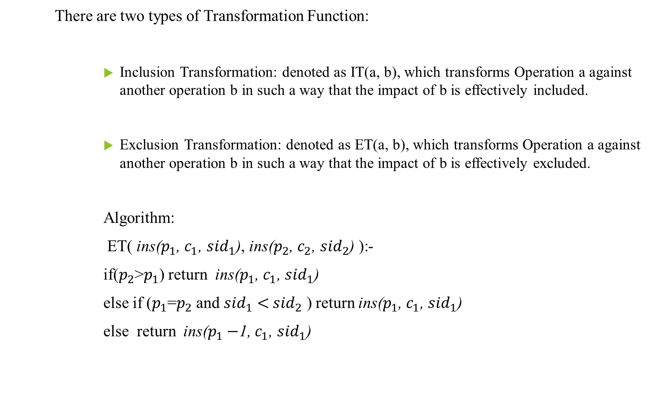
Continued…
There are two types of Transformation Function:
Inclusion Transformation: denoted as IT(a, b), which transforms Operation a against another operation b in such a way that the impact of b is effectively included.
Exclusion Transformation: denoted as ET(a, b), which transforms Operation a against another operation b in such a way that the impact of b is effectively excluded.
Algorithm:
ET( ins($p_{1}$, $c_{1}$, ${sid}_{1}$), ins($p_{2}$, $c_{2}$, ${sid}_{2}$) ):-
if($p_{2}$>$p_{1}$) return ins($p_{1}$, $c_{1}$, ${sid}_{1}$)
else if ($p_{1}$=$p_{2}$ and ${sid}_{1}<{ sid}_{2}$ ) return ins($p_{1}$, $c_{1}$, ${sid}_{1}$)
else return ins($p_{1}−$1, $c_{1}$, ${sid}_{1}$)

Slide 12

Design of character-wise transformation functions
$Case 1: T_{1}$(ins($p_{1}$, $c_{1}$), ins($p_{2}$, $c_{2}$)){
if($p_{1}<p_{2}$ or ${(p}_{1}$= $p_{2}$ and $u_{1}$>$u_{2}$))
return ins($p_{1}$, $c_{1}$);
else return ins($p_{1}$+1, $c_{1}$);}
Case 2: $T_{2}$(ins($p_{1}$, $c_{1}$), del($p_{2}$)){
if($p_{1}≤p_{2})$
return ins($p_{1}$, $c_{1}$);
else return ins($p_{1}−$1, $c_{1}$);}

Slide 13
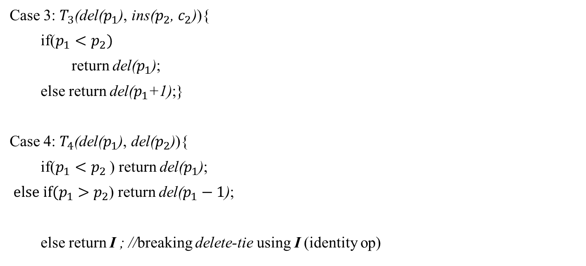
Continued…
Case 3: $T_{3}$(del($p_{1}$), ins($p_{2}$, $c_{2}$)){
if($p_{1}<p_{2})$
return del($p_{1}$);
else return del($p_{1}$+1);}
Case 4: $T_{4}$(del($p_{1}$), del($p_{2}$)){
if($p_{1}<p_{2}$ ) return del($p_{1}$);
${else if(p}_{1}>p_{2}$) return del($p_{1}−1$);
else return I ; //breaking delete-tie using I (identity op)

Slide 14
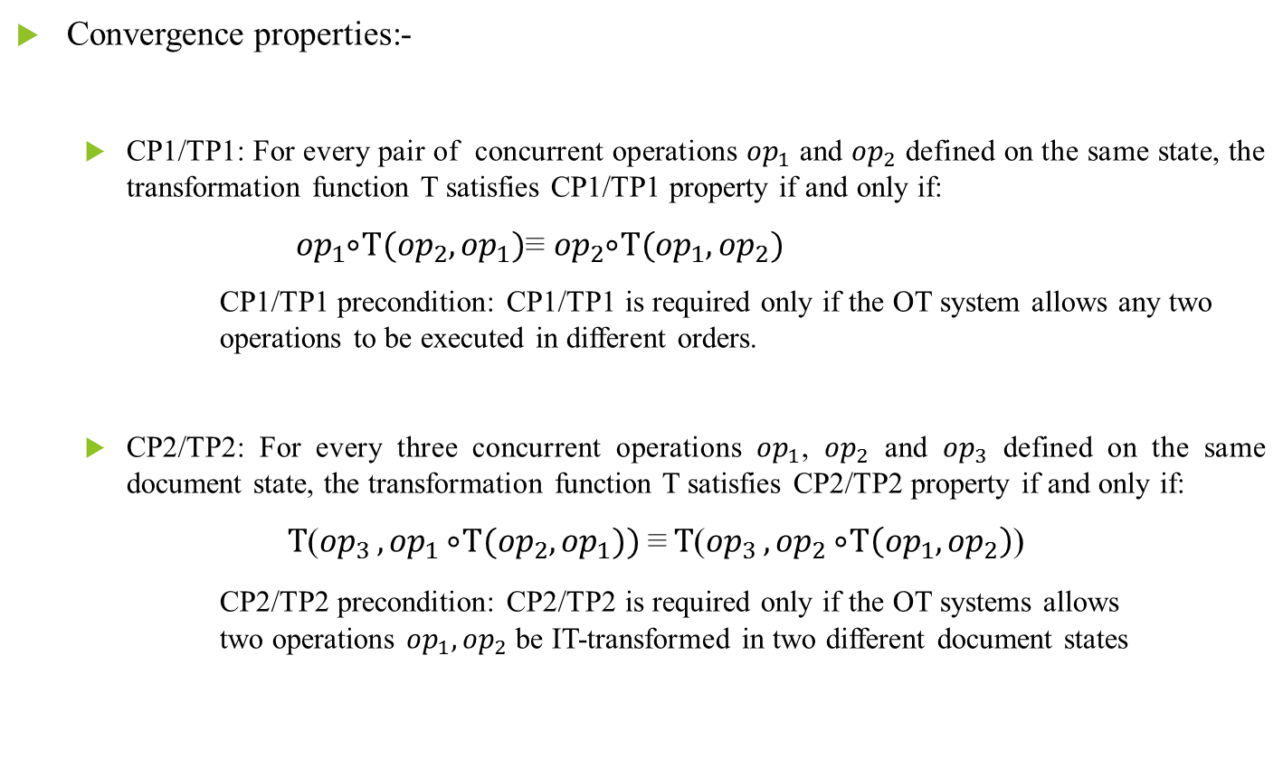
Transformation properties
Convergence properties:-
CP1/TP1: For every pair of concurrent operations ${op}_{1}$ and ${op}_{2}$ defined on the same state, the transformation function T satisfies CP1/TP1 property if and only if:
${op}_{1} ⃘⃘⃘T({op}_{2},{op}_{1})$≡ ${op}_{2} ⃘⃘⃘T({op}_{1},{op}_{2})$
CP1/TP1 precondition: CP1/TP1 is required only if the OT system allows any two operations to be executed in different orders.
CP2/TP2: For every three concurrent operations ${op}_{1}$, ${op}_{2}$ and ${op}_{3}$ defined on the same document state, the transformation function T satisfies CP2/TP2 property if and only if:
$T$(${op}_{3 },{op}_{1} ⃘⃘⃘T({op}_{2},{op}_{1}))$≡$T$(${op}_{3 },{op}_{2} ⃘⃘⃘T\left({op}_{1},{op}_{2}\right)$)
CP2/TP2 precondition: CP2/TP2 is required only if the OT systems allows two operations ${op}_{1},{op}_{2}$ be IT-transformed in two different document states

Slide 15
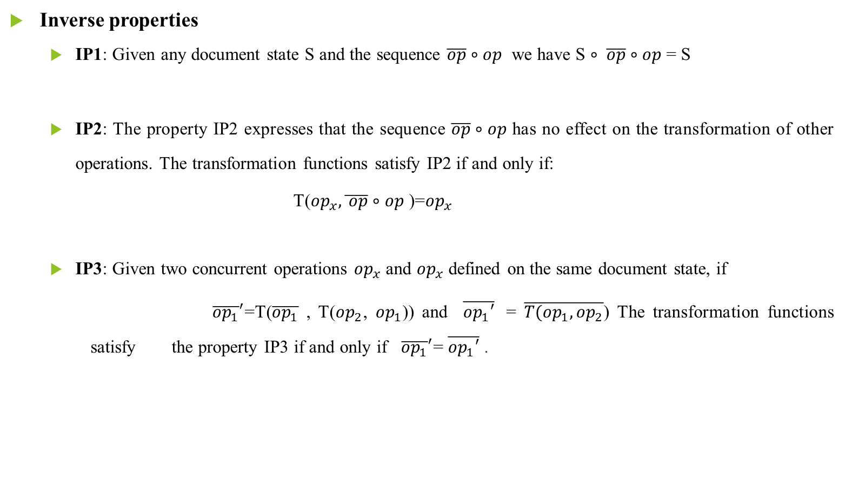
Continued…
Inverse properties
IP1: Given any document state S and the sequence $\overline{op}∘op$ we have S $∘ \overline{op}∘op$ = S
IP2: The property IP2 expresses that the sequence $\overline{op}∘op$ has no effect on the transformation of other operations. The transformation functions satisfy IP2 if and only if:
T(${op}_{x},\overline{ op}∘op$ )=${op}_{x}$
IP3: Given two concurrent operations ${op}_{x}$ and ${op}_{x}$ defined on the same document state, if
${\overline{{op}_{1}}}^{′}$=T($\overline{{op}_{1}}$ , T(${op}_{2}$, ${op}_{1}$)) and $\overline{{op}_{1}′}$ = $\overline{{T(op}_{1},{op}_{2}}$) The transformation functions satisfy the property IP3 if and only if ${\overline{{op}_{1}}}^{′}$= $\overline{{op}_{1}′}$ .

Slide 16
Different types of OT algorithm
1. dOPT — distributed OPerational Transformation
The dOPT Algorithm was one of the first approaches to OT.
It uses a transformation matrix, denoted as T, is what solves conflicting operations. T is a m x m matrix, where m is the number of supported operations in the group-ware system. Each entry in the matrix is a function which transforms operations into other operations and to ensure convergence dOPT requires the Transformation Property 1 (i.e. TP1 ).
Shortcomings
It fails whenever an operation is concurrent with two or more dependent operations.
This algorithm is distributed and does not have a central server.

Slide 17
Continued…
2. adOPTed Algorithm
The shortcomings in dOPT were in the way it transformed operations. The adOPTed introduced the second transformation property [TP2] which ensures that transformation of an operation along different paths will yield the same resulting operation.
Shortcomings:
It does not proved the Intention Preservation property,

Slide 18
Continued…
3. GOT — Generic Operational Transformation
GOT control algorithm maintains convergence nicely. Also, it is integrated with Undo/Do/Redo Scheme which states that when a new operation O is ready.
Undo operations in History Buffer (HB) (which is defined as ‘saved executed operations at each site’) which totally follow O to restore the document to the state before their execution.
Do O (the operation)
Redo all operations that were undone from the HB.
Shortcomings
The algorithm only supports basic string operations (i.e. Insert/Delete). Also, correctness proof of algorithm is missing.

Slide 19
Continued…
4. GOTO— Generic Optimized Operational Transformation
GOTO Algorithm is the Optimized version of GOT Algorithm. The optimization takes place because of two post conditions, TP1 and TP2.
GOTO algorithm uses the function convert2HC() which basically uses ET between an insert and a delete [concurrent], what basically happens is we transpose the entire history to obtain the concurrent operations when integrating a remote operation.
Shortcomings
It was never theoretically proven correct for all scenarios.

Slide 20
Continued…
5. Google Wave OT Algorithm
Google Wave OT is basically based on the dOPT algorithm.
It Introduced Client-Server Architecture.
Google’s Operational Transformation algorithm modifies the basic theory of OT by requiring the client to wait for acknowledgement [ACKs].
the server only needs to have a single state space, which is the history of operations it has applied. When it receives a client’s operation, it only needs to transform the operation against the operation history.
Shortcomings
It is lagged at intention Preservation.

Slide 21
Collaborative editing system
What is Collaborative editing system?
Collaborative editing is a process of writing and editing documents or projects by more than one person.
Collaborative editing can be performed in real-time or in non-real-time.
Challenges in Real time collaborative editing tools
Consistency maintenance in the face of concurrent accesses to shared objects is one of the core issues in the design of these types of systems.
Concurrency control.
Consistency
Network latency

Slide 22
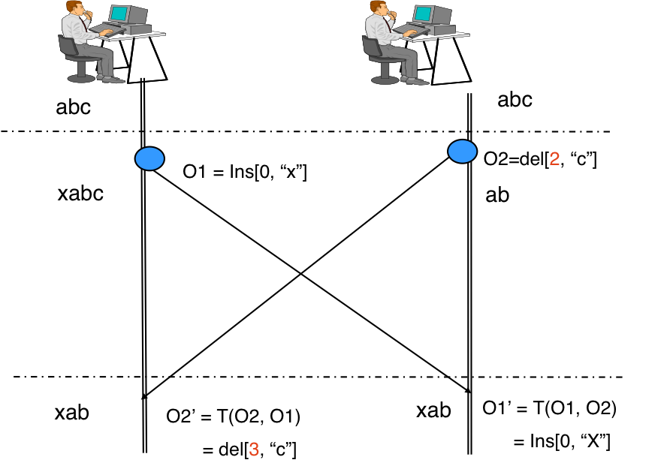
How consistency and concurrency are maintained in OT?
Two Current Operations:
O1 = Insert[0, "x"] (to insert character "x" at position "0").
O2 = Delete[2, "c"] (to delete the character "c" at position "2").
In order to maintain the consistency OT transforms the parameters of an editing operation according to the effects of previously executed concurrent operations.

Slide 23
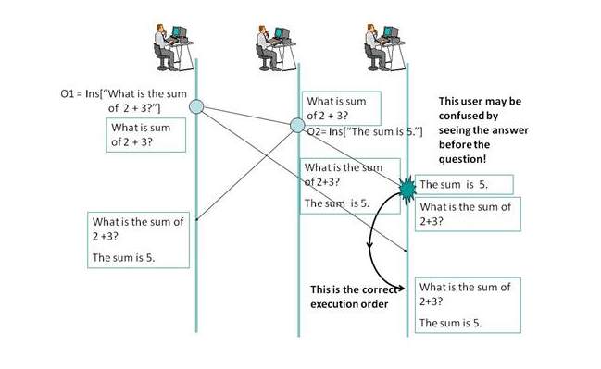
Need of OT in CE
At the first result (at site 3)of cause-effect relation is not maintained.
The causality violation problem can be solved using State Vector Timestamp.
State Vector Timestamp used to determine happened-before relation between two operations .

Slide 24
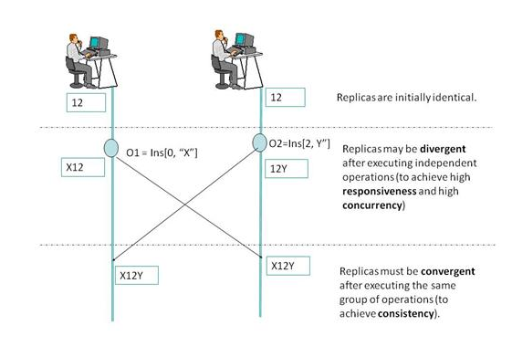
Continued…
Convergence requirement
Convergence requires the copies of the shared document be identical when the same group of operations has been performed, particularly at the end of a collaboration session.

Slide 25
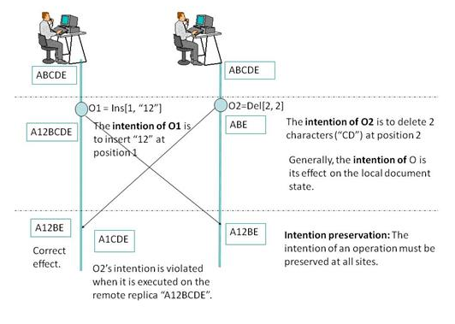
Continued…
Intention preservation requirement
the intention of an operation be preserved at all sites, regardless of interleaving execution of concurrent operations.
Intention preservation can be achieved using Inclusion Transformation function

Slide 26
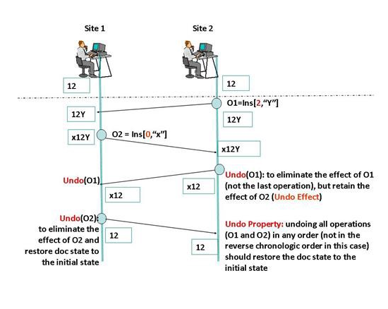
Undo Related Application
One is the undo effect, which requires that undoing an operation O achieves the effect of eliminating the effect of O but retains the effects of other operations in the document.

Slide 27
Conclusion
Operational Transformation is a very powerful tool that allows building great collaborative apps with support for non-blocking concurrent editing.
It ensures the Convergences.
It ensures the intention preservation.
It ensures the causality preservation.
It’ll give the user a real time working environment.

